Slide 1

ANALYZING HEALTHCARE COST INFORMATION FROM A HMO (HEALTH MANAGEMENT ORGANIZATION)
IST 687: INTRODUCTION TO DATA SCIENCE
Group 5
Abhijeet | Anish | Madhumitha | Pulak | Samragyee | Saurav

Slide 2

AGENDA
| HMO
| GOALS & INITIAL ANALYSIS
| DATA VISUALIZATION
| MODELS
| RECOMMENDATIONS

Slide 3

HMO

Slide 4


Slide 5
Data Description
Variable | Variable Type | Description
X | Integer | Unique identifier for each person
age | Integer | The age of the person (at the end of the year)
location | Categorical | The name of the state (in the United States) where the person lived (at the end of the year)
location_type | Categorical | A description of the environment where the person lived (urban or country)
exercise | Categorical | “Not-Active” if the person did not exercise regularly during the year, “Active” if the person did exercise regularly during the year
smoker | Categorical | “yes” if the person smoked during the past year, “no” if the person didn’t smoke during the year
bmi | Integer | The body mass index of the person. The body mass index (BMI) is a measure that uses your height and weight to work out if your weight is healthy
yearly_physical | Categorical | “yes” if the person had a well visit (yearly physical) with their doctor during the year. “no” if the person did not have a well visit with their doctor
Hypertension | Categorical | “0” if the person did not have hypertension
gender | Categorical | The gender of the person
education_level | Categorical | The amount of college education ("No College Degree", "Bachelor", "Master", "PhD")
married | Categorical | Describing if the person is “Married” or “Not_Married”
num_children | Integer | Number of children
cost | Integer | The total cost of health care for that person, during the past year

Slide 6

GOALS & INITIAL ANALYSIS

Slide 7

Goals
• Predict people who will spend a lot of money on health care next year (i.e., which people will have high healthcare costs).
• Provide actionable insight to the HMO, in terms of how to lower their total health care costs, by providing a specific recommendation on how to lower health care costs.

Slide 8
Initial Analysis
Part 1: Data Acquisition
Import the data file
Reading the csv file using read_csv function
Part 2: Data Exploration
Checking the number of rows and columns in the dataset
Checking for NA's/missing values in the dataset
Checking for duplicated rows
Part 3: Data Cleaning
Replacing missing data with substituted values in 'bmi' column
Removing rows with missing values in 'hypertension' column

Slide 9
Initial Analysis
The dataset contains 7,582 rows and 14 columns, where the 'X' column represents the unique identifier.
The 'smoker', 'yearly_physical', 'exercise', 'married', and 'gender' columns have binary values.
The 'bmi' and 'hypertension' columns contain missing values.
The 'location' and 'location_type' columns indicate the location and type of location, respectively.
The 'education_level' column indicates the highest education level of the individual.
The 'cost' column represents the medical cost of the individual.
After cleaning the dataset we were left with 7,502 rows and 14 columns.

Slide 10

DATA VISUALIZATION & MODELS

Slide 11
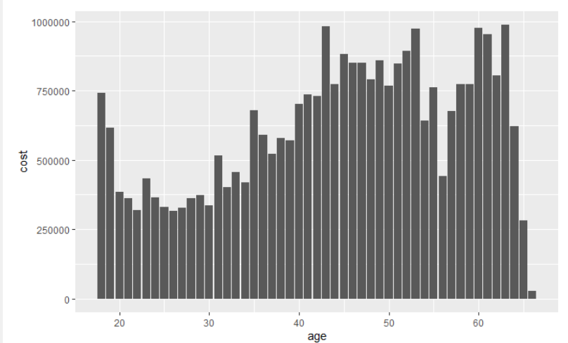
Age vs Cost Bar Plot

Slide 12
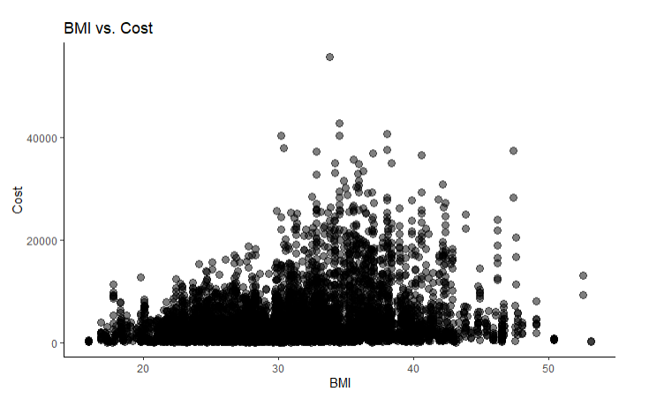
Relationship of BMI and Cost

Slide 13
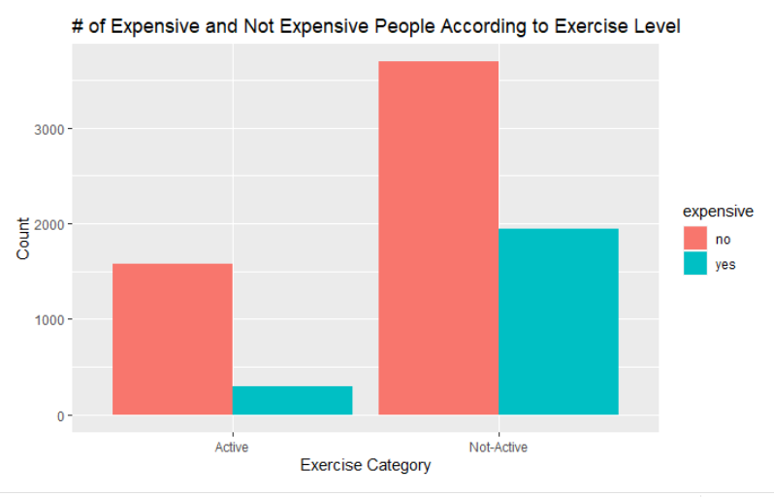
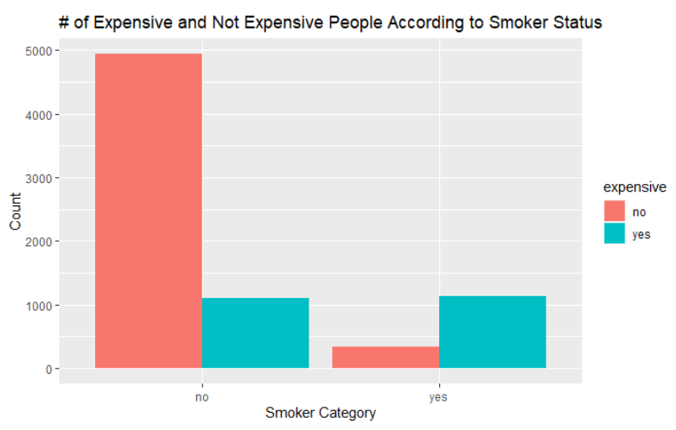
Expensive and Non-Expensive People based on different Categories

Slide 14
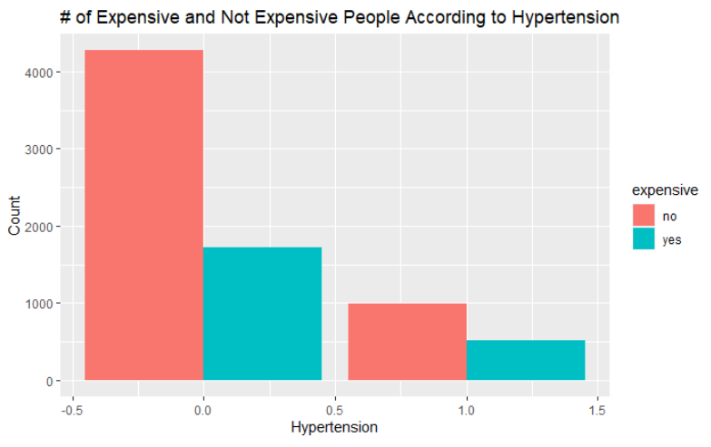
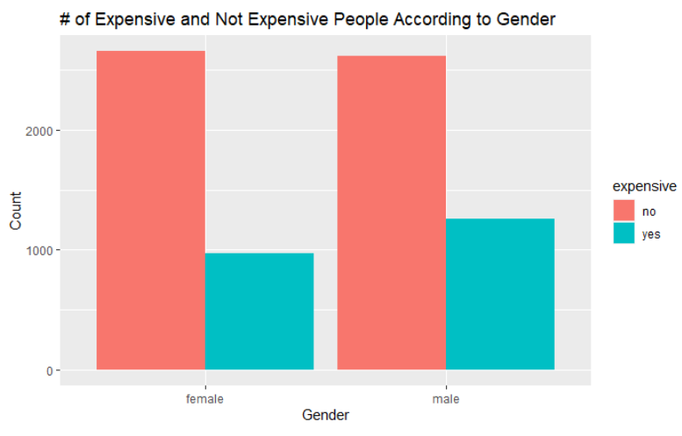
Expensive and Non-Expensive People based on Different Categories

Slide 15
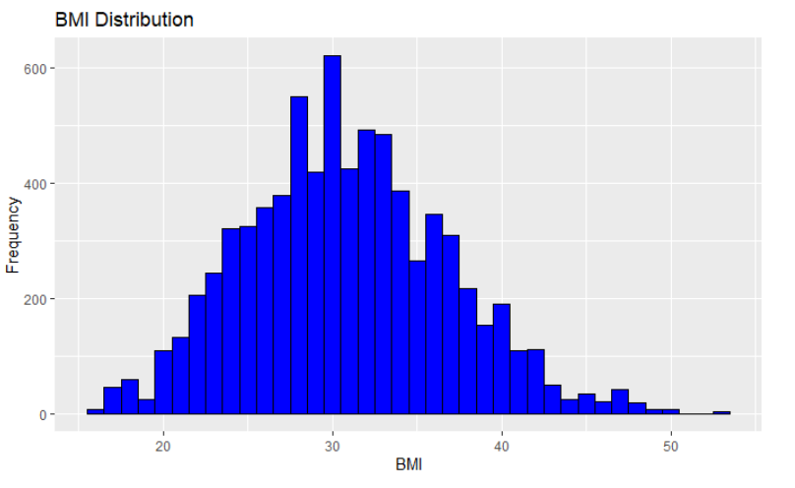
Histogram of BMI

Slide 16
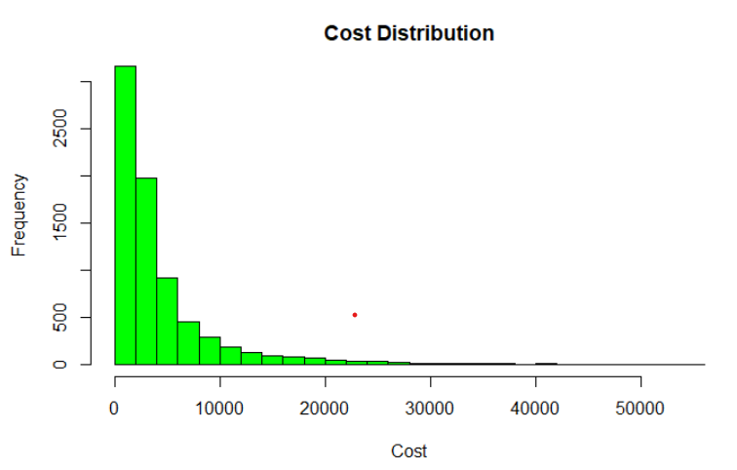
Cost distribution

Slide 17
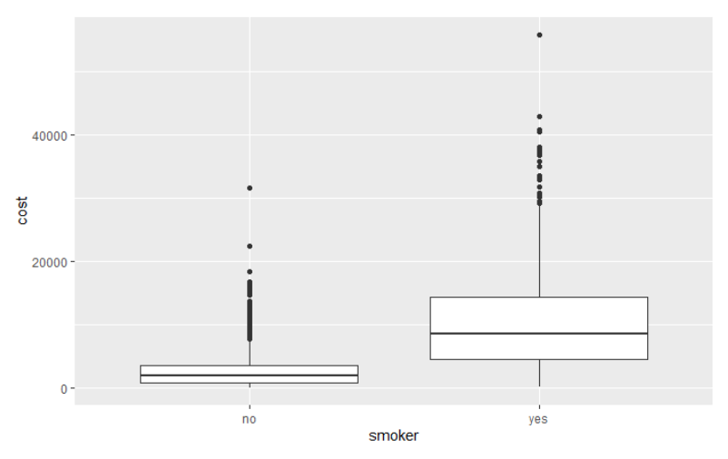
Boxplot of Smoker

Slide 18
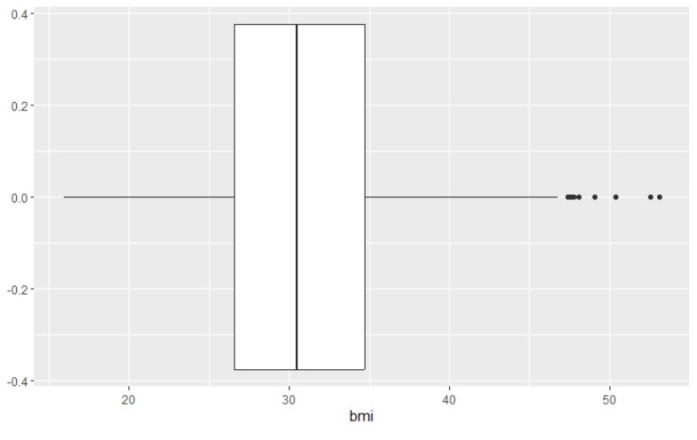
Boxplot of BMI

Slide 19
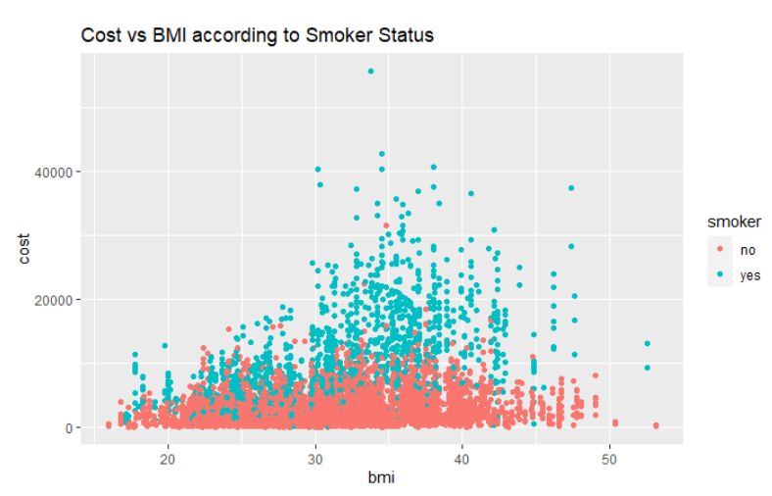
Scatterplot of BMI and Cost with Smoker Status

Slide 20
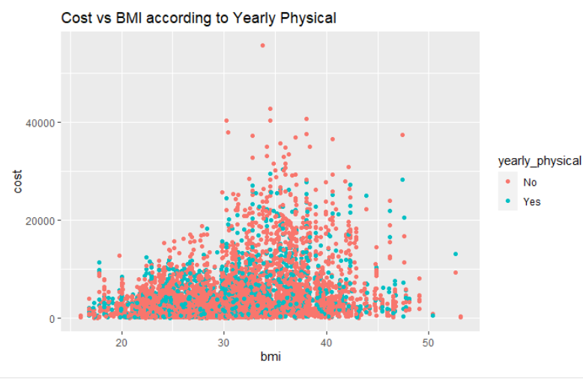
Scatterplot of BMI and Cost with Yearly Physical Checkup

Slide 21
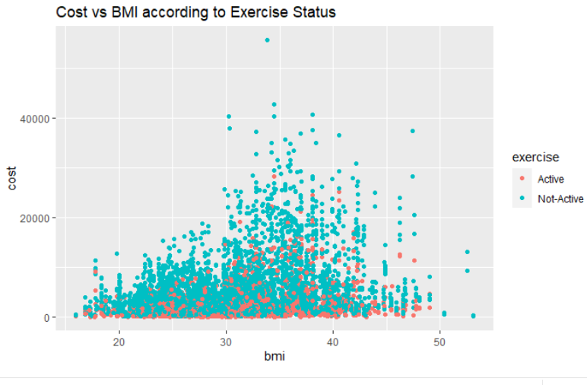
Scatterplot of BMI and Cost with Exercise Status

Slide 22
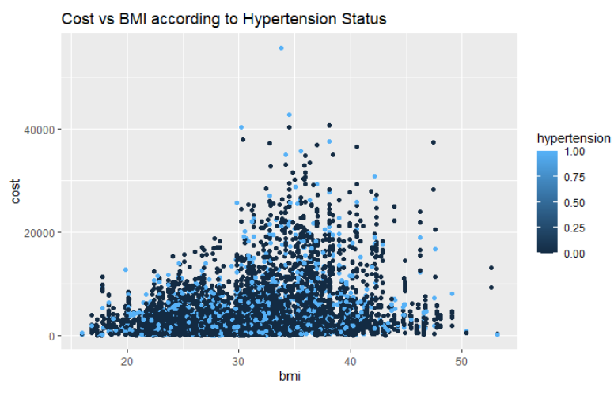
Scatterplot of BMI and Cost with Hypertension Status

Slide 23
Comparison of Models - Accuracy and No-Information Rate
Model | Accuracy | No-Information Rate
SVM | 80.87% | 70.27%
KSVM | 84.53% | 70.27%
Partition Tree | 85.4% | 70.27%

Slide 24
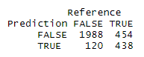
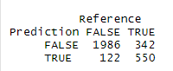
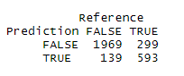
Comparison of Models - Confusion Matrix
SVM
KSVM
Partition Tree

Slide 25

RECOMMENDATIONS

Slide 26
Recommendations
Encourage Healthy Habits : The data suggests that individuals who are physically active tend to have lower medical costs. The HMO could consider promoting and incentivizing healthy habits such as regular exercise to help prevent chronic health conditions that can lead to costly medical interventions.
Offer Smoking Cessation Programs : The data suggests that smokers tend to have higher medical costs. The HMO could consider offering smoking cessation programs to help individuals quit smoking and reduce their risk of developing costly healthy conditions.
Monitor High-Risk Individuals : The data also indicates that individuals with hypertension tend to have higher medical costs. The HMO could consider implementing a monitoring system to identify and manage high-risk individuals with chronic health conditions to prevent costly complications.

Slide 27

Thank you…

